Slide 1

Fin-Dex Discover the ABCDs of Tomorrow
Made with HTML, CSS in Replit
By Matias Fong
Code: https://github.com/codermat123/Matias-Portfolio

Slide 2
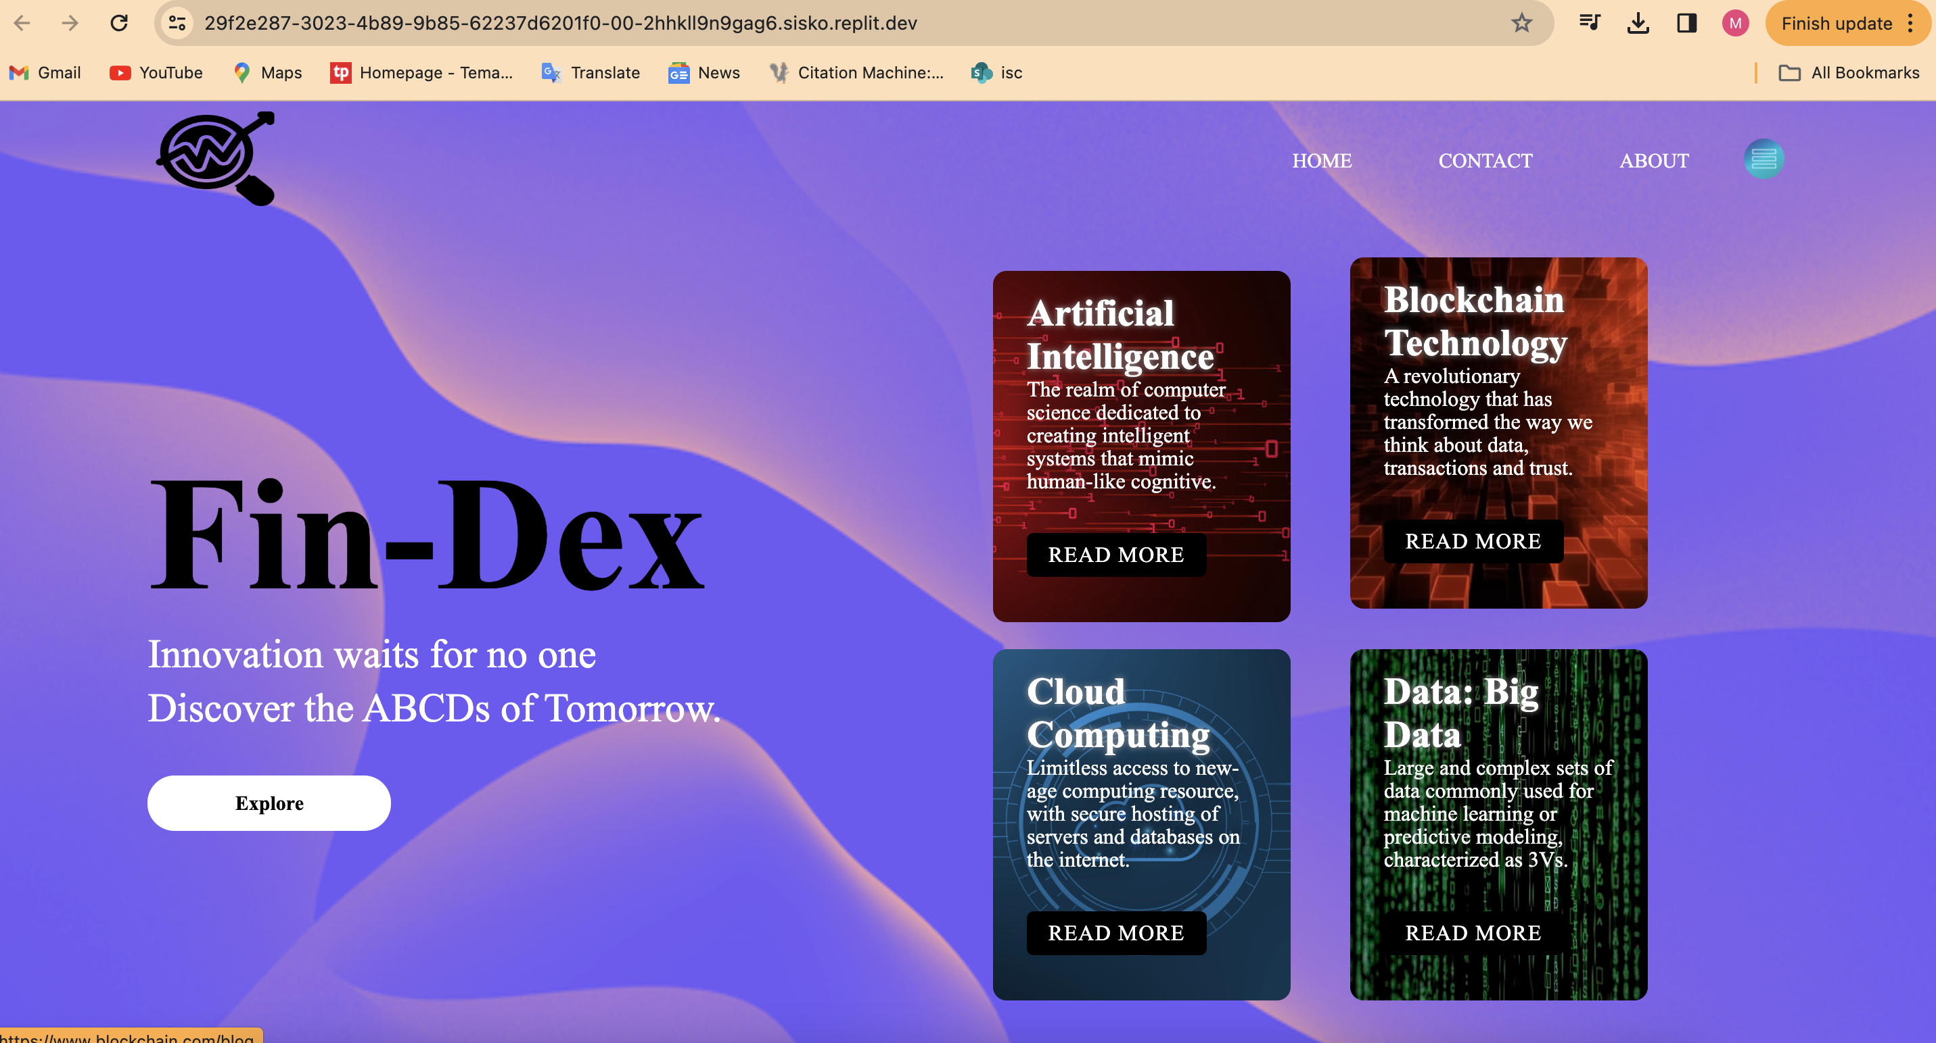
Home page
Interactive button that redirects

Slide 3
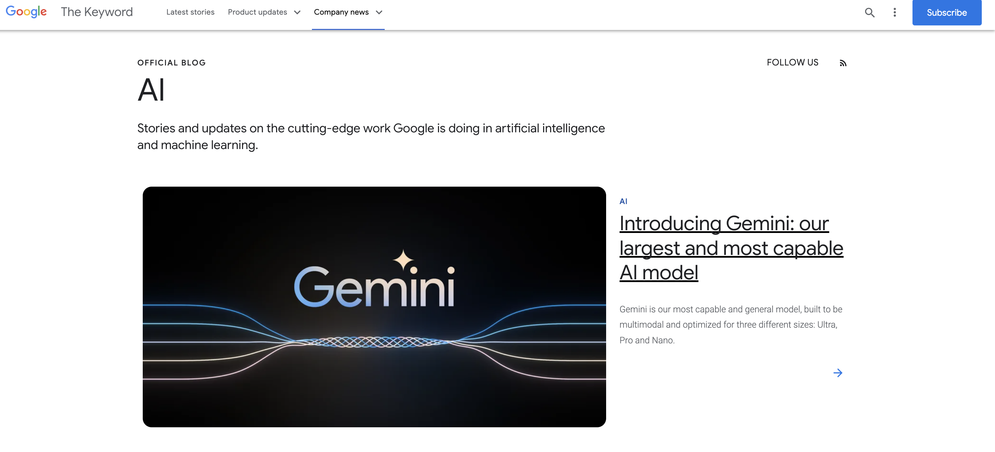
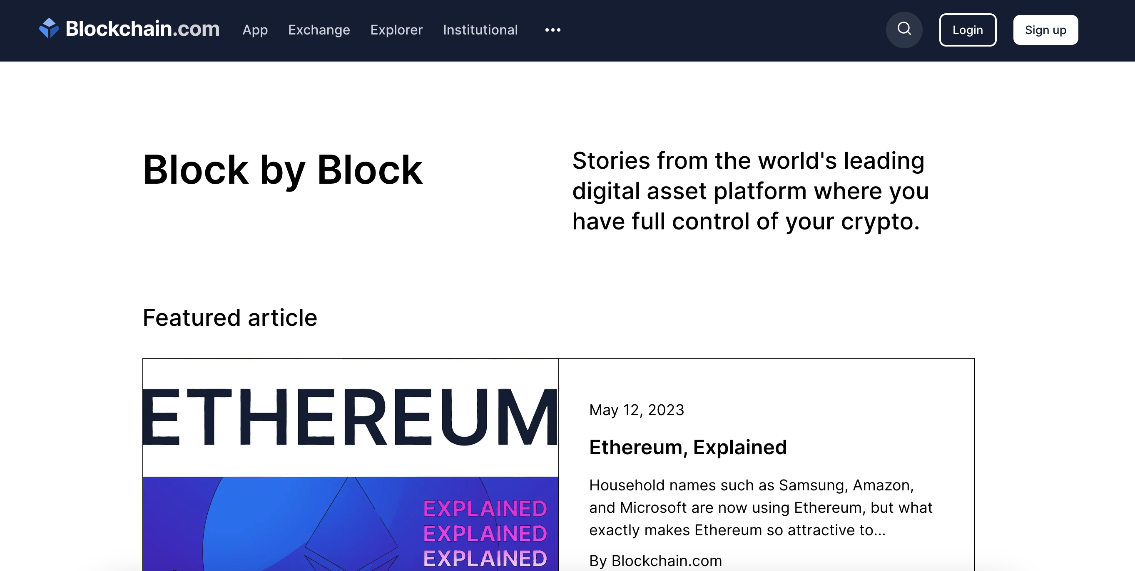
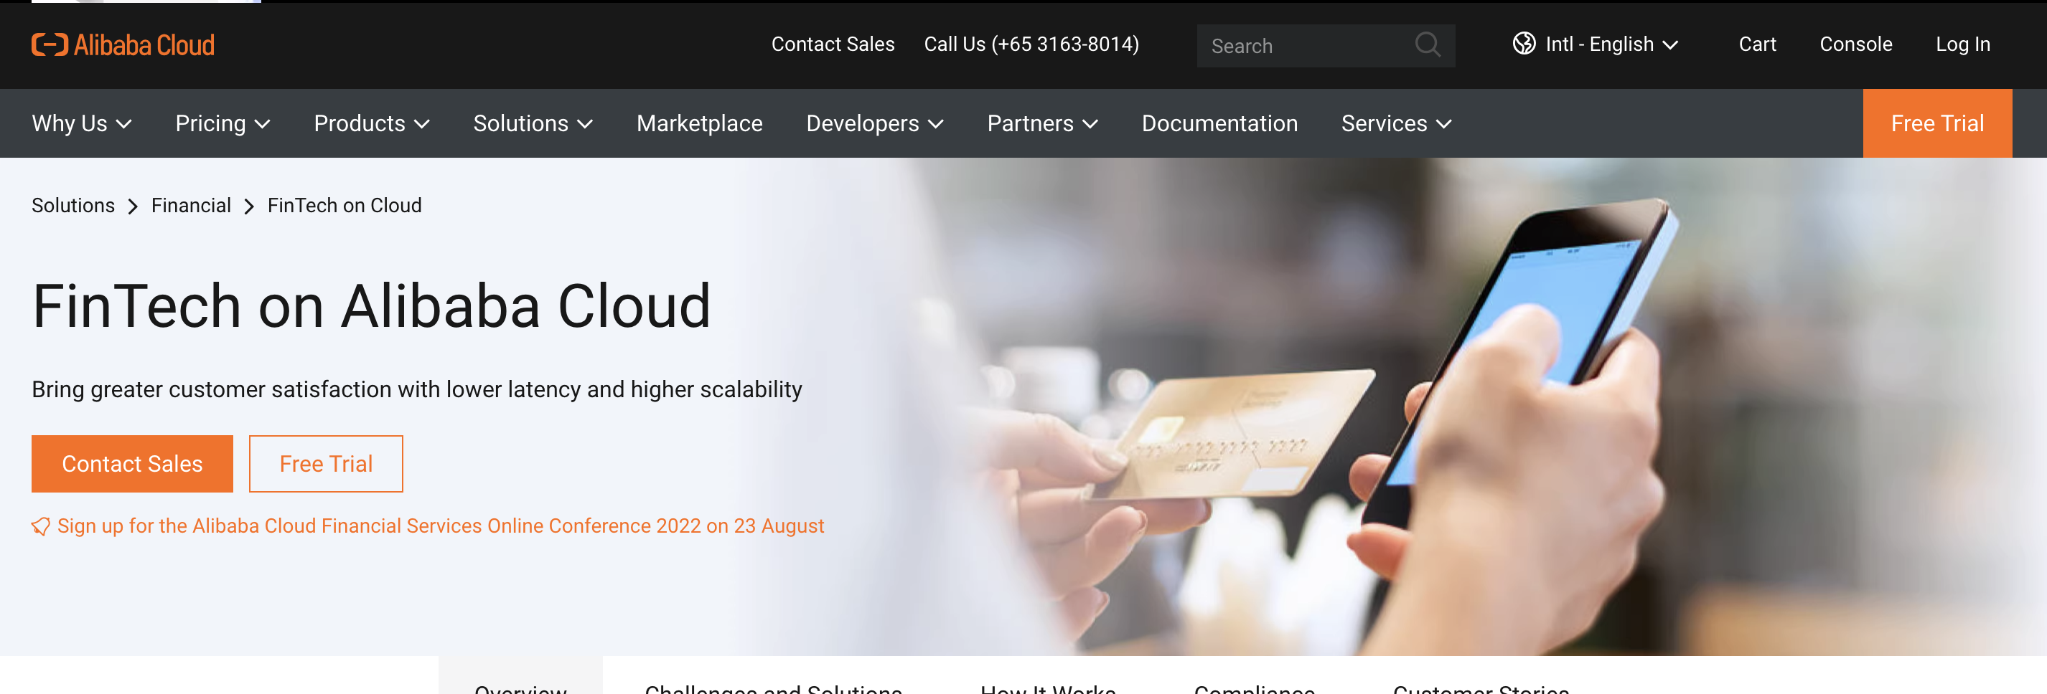
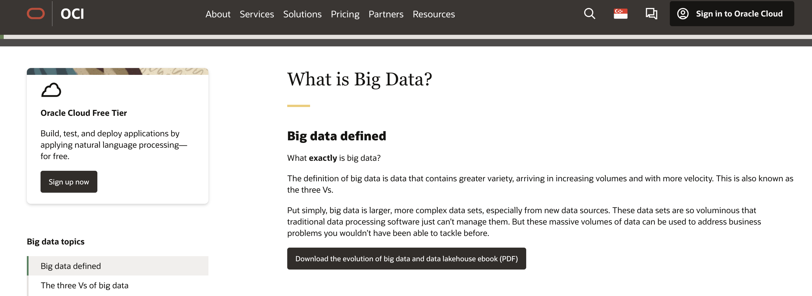
Read more redirects to:
Artificial intelligence:
Blockchain:
Cloud computing:
Big data:
AI google blog
Oracle big data blog
Blockchain.com blog
Alibaba cloud blog

Slide 4
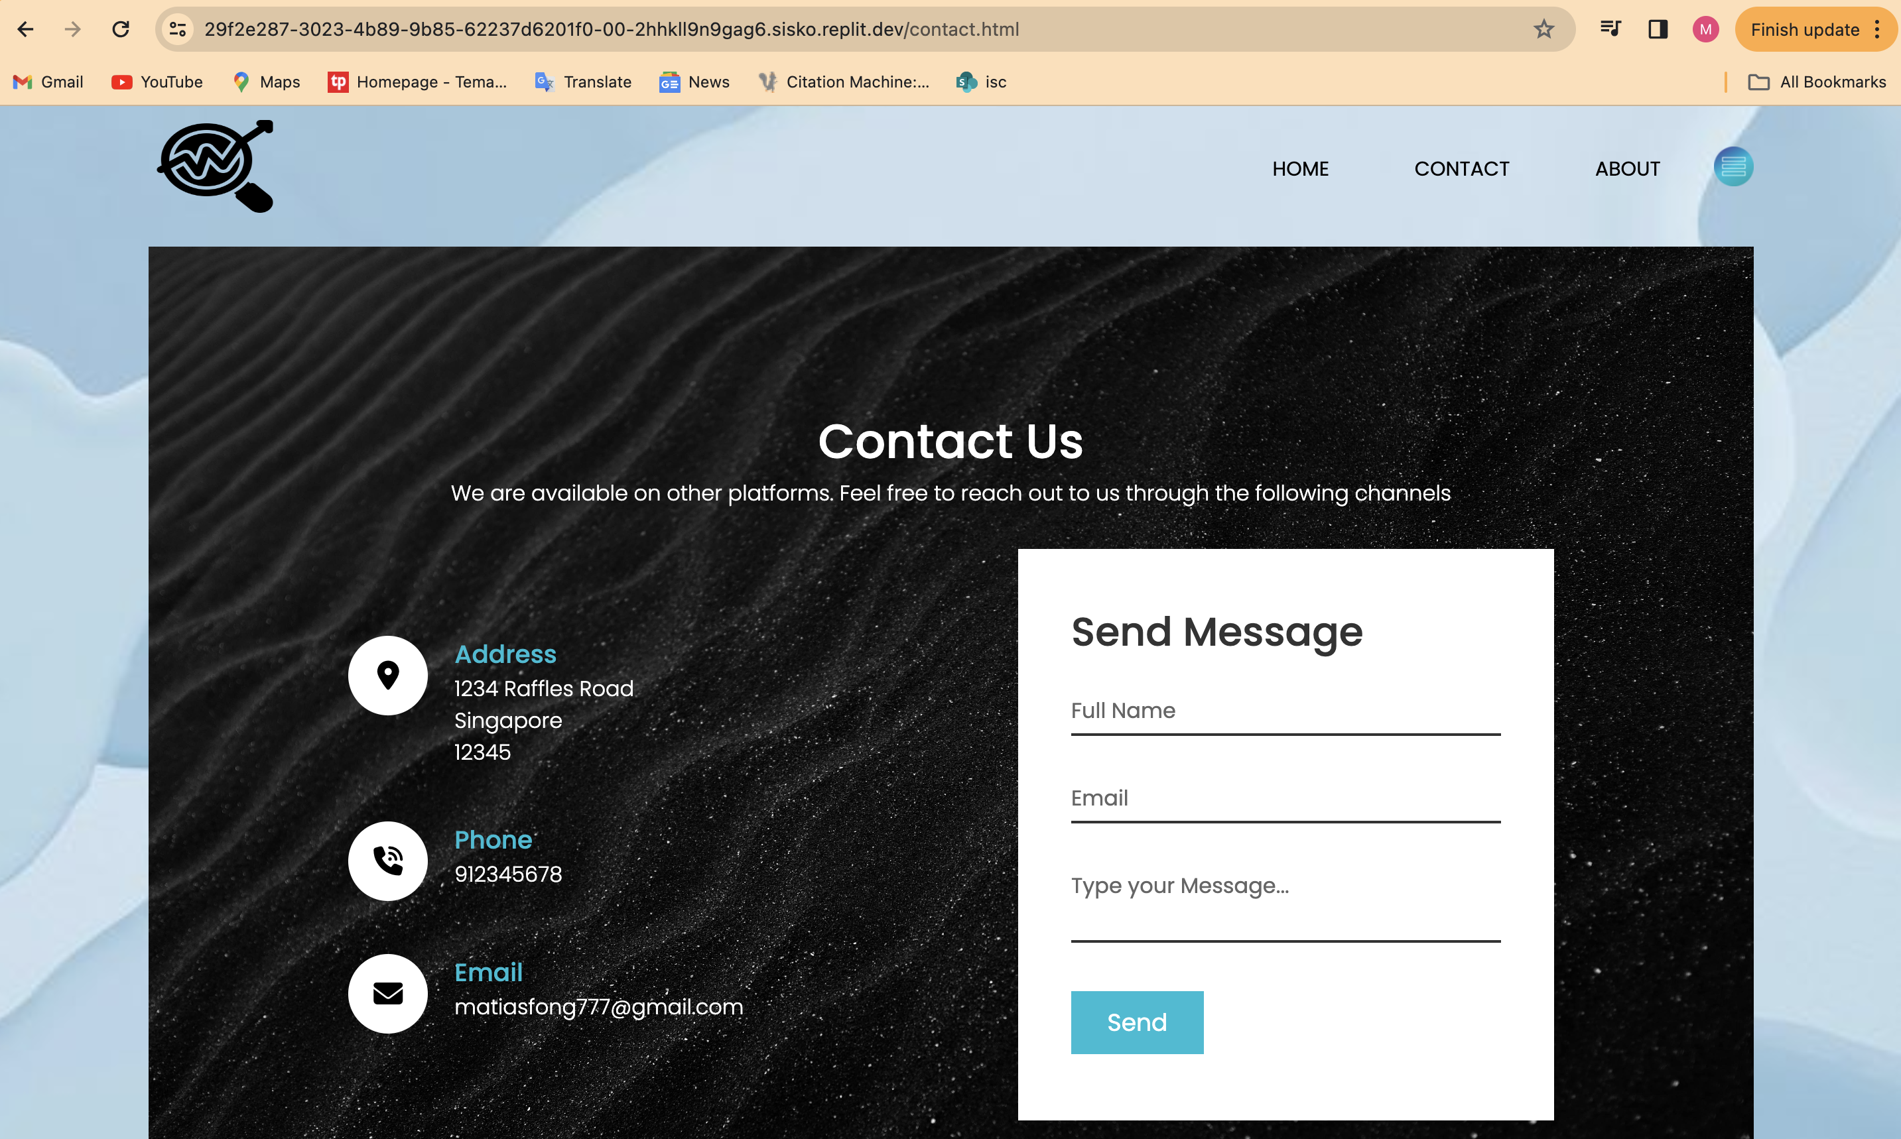
Contact page

Slide 5
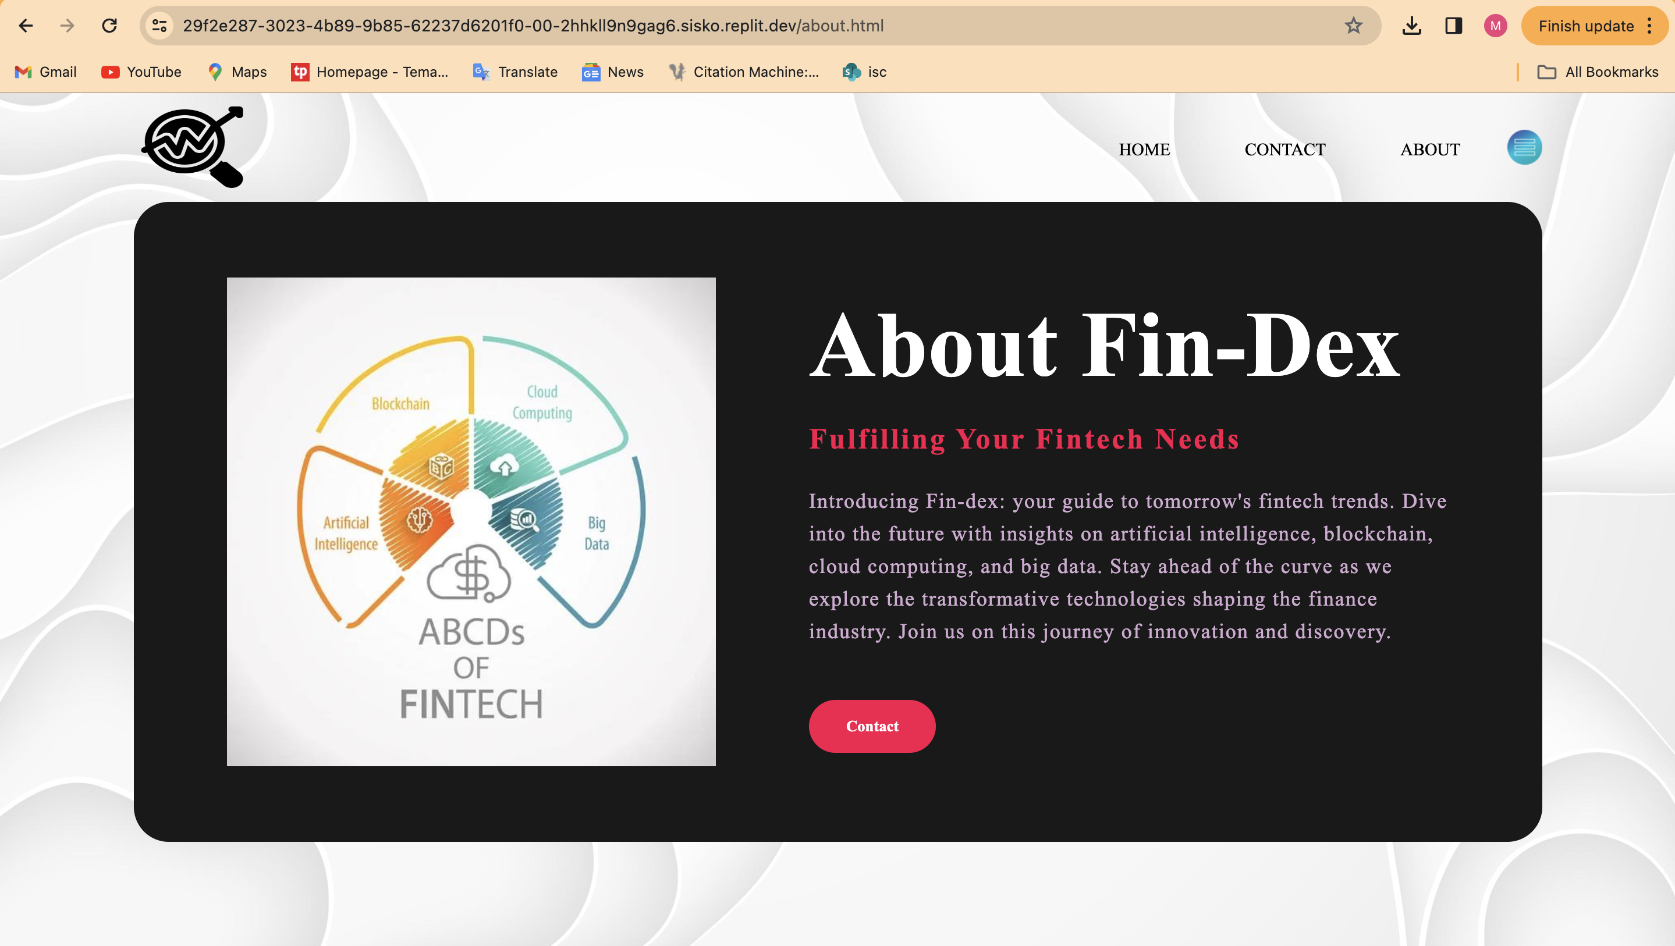
About page

